Slide 1
INFORMATION SECURITY
Hash Functions And Other Topics
1

Slide 2
Presentation by
Sunaan Sultan (ASH1925004M)
Dhruba Kanti Bakshi(ASH1825018M)
Supervised by
Falguni Roy
Assistant Professor, IIT, NSTU
2

Slide 3
What is a Hash Function?
Features and properties of a Hash Function?
How Hashing works?
The birthday problem.
Cryptographic and non cryptographic hash function
HMAC
Uses Of hash functions
Application of hash function
Other crypto related topics
Contents
OVERVIEW OF THE TOPICS
3

Slide 4
A hash function is a mathematical function that converts a numerical input value into another compressed numerical value.
hash functions takes in variable sized message and produces a fixed size output, regardless of the length of the input.
A Hash value ‘h’ is generated by a function H(hash function) such that H(m) = fixed length code ‘h’ also known as hash code.
Because hash functions have infinite input length and a predefined output length, there is going to be the possibility of two different inputs that produce the same output hash. ...
If two separate inputs produce the same hash output, it is called a hash collision.
What is a Hash
Function?
4

Slide 5
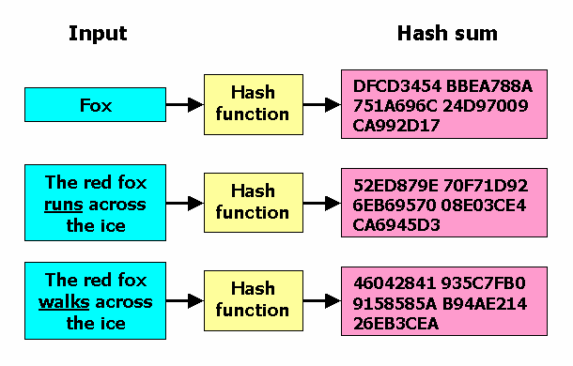
5

Slide 6
Fixed Length Output (Hash Value)
Hash function coverts data of arbitrary length to a fixed length. This process is often referred to as hashing the data.
In general, the hash is much smaller than the input data, hence hash functions are sometimes called compression functions.
Since a hash is a smaller representation of a larger data, it is also referred to as a digest.
Efficiency of Operation
Generally for any hash function h with input x, computation of h(x) is a fast operation.
Computationally hash functions are much faster than a symmetric encryption.
Features of Hash Function
6

Slide 7
Properties of Hash Function
The ideal cryptographic hash function has the following main properties:
Deterministic: This means that the same message always results in the same hash.
Quick: It is quick to compute the hash value for any given message.
Avalanche Effect: This means that every minor change in the message results in a major change in the hash value.
One-Way Function: You cannot reverse the cryptographic hash function to get to the data.
Collision Resistance: It is infeasible to find two different messages that produce the same hash value.
7

Slide 8
How Hashing Works
to get the hash value of a pre-set length, divide the input data into fixed sized blocks. This is because a hash function takes in data at a fixed-length.
These blocks are called ‘data blocks.’
The algorithm then applies the hashing process to each data block separately.
Although one block is hashed individually, all of the blocks are interrelated.
The size of the data block(s) differs from one algorithm to another. But for a particular algorithm, it remains the same
8

Slide 9
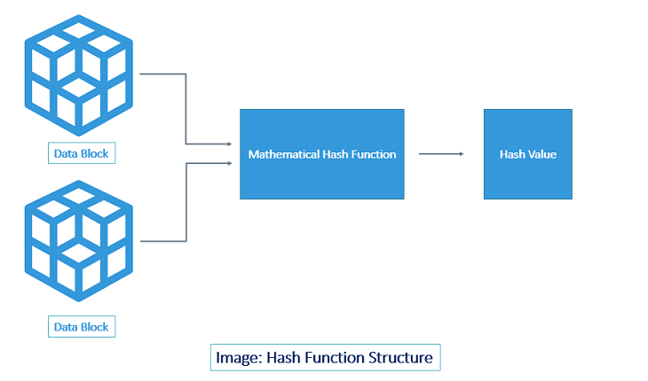
9

Slide 10
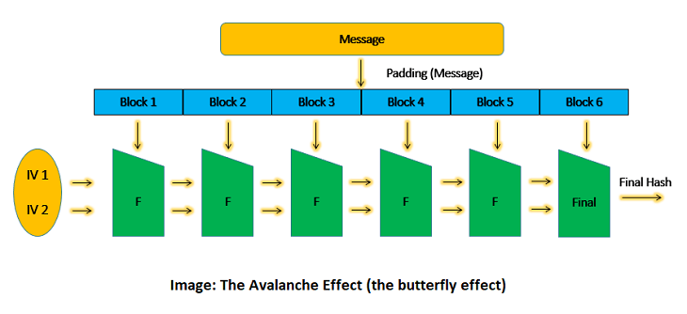
How Hashing Works
the entire message is divided into fixed-size data blocks using padding.
The hash function is repeated as many times as the number of data blocks.
the blocks are processed one at a time.
the output of the first data block is fed as input along with the second data block.
the output of the second is fed along with the third block and so on.
Thus, we are making the final output the combined value of all the blocks.
If one bit is changed anywhere in the message, the entire hash value changes.
10

Slide 11
Birthday Attacks
A birthday attack belongs to the family of brute force attacks and is based on the probability theorem. It is a cryptographic attack and its success is largely based on the birthday paradox problem.
The birthday attack is used to create hash collisions.
Just as matching your birthday is difficult, finding a specific input with a hash that collides with another input is difficult. However, just like matching any birthday is easier, finding any input that creates a colliding hash with any other input is easier due to the birthday attack.
11

Slide 12
The Birthday Paradox
In a room with 23 people or more, the odds are greater than 50% that two people will share the same birthday.
If you are in a room full of 23 people, you have a 1/365 chance of sharing a birthday with each of the 22 other people in the room, for a total of 22/365 chances.
If you fail to match, you leave the room and Bob has a 2/365 chance of sharing a birthday with the remaining people.
If Bob fails to match, he leaves the room and alice has a 3/365 chance,
If you add 1/365 + 2/365 + 3/365 + 4/365 … + 22/365, you get greater than 50% probability
Likewise to get a probability of 99.9% you need 70 people in the room, and to get 100 % probability you need 366 people.
12

Slide 13
Cryptographic and non-cryptographic Hash functions
In a good cryptographic hash function changing one bit in the input should, on average, change 50% of the bits in the out put. In a noncryptographic function this feature is not frequently present, and sometimes might not even be desirable.
The main difference between cryptographic hashes and non cryptographic hashes is “uniqueness”. An acceptable cryptographic hash has all the properties of a non-cryptographic hash, plus the fact that it creates a unique hash output.
A cryptographic hash should resist Preimage attack and Collision attack And also that it must have the Avalanche effect. Whereas non-cryptographic hashes usually guarantee higher computational speed when compared to a cryptographic hash function.
13

Slide 14
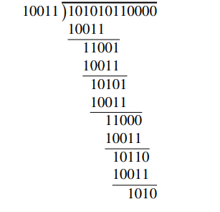
Non-Cryptographic Hash functions
a non-cryptographic “hash” that is widely used is the cyclic redundancy check, or CRC [247]. This calculation is essentially long division, with the remainder acting as the CRC value. The difference with ordinary long division is that XOR is used in place of subtraction. suppose the divisor is 10011 and the data is 10101011. Then we append four 0s to the data and the CRC calculation is
In case of X-OR
1+1 = 0,
0+0 = 0,
0+1 = 1,
1+0 = 1
The CRC value will be added to the input msg for encryption and sent to the receiver
14

Slide 15
HMAC
HMAC stands for Hashed-based Message Authentication Code and is used to verify the integrity and authenticity of a message.
HMAC can be used with any iterative cryptographic hash function e.g., MD5, SHA-1, SHA-256, SHA-512 in combination with a shared secret key. If used with MD5, it is called HMAC-MD5. If used with SHA-1, it is called HMAC-SHA1. etc.
Once the HMAC hash is calculated, the message must be sent alongside the HMAC hash.
15

Slide 16
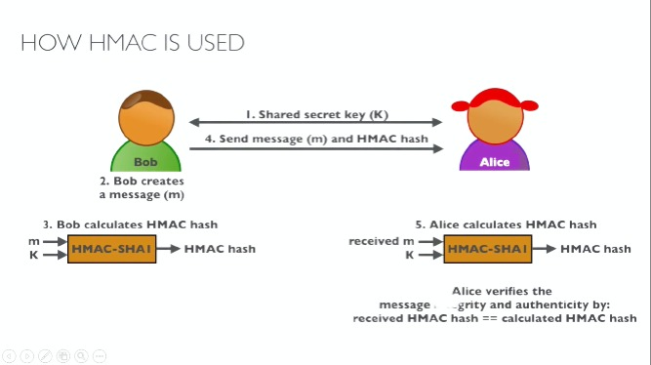
16

Slide 17
HMAC
ADVANTAGES
HMACs are considered to be good high-performance systems. It is because of the hash functions used, which are quick both in terms of calculation as well as verification.
Since it uses hashing twice, it is great for cryptanalysis attacks.
The main advantage is speed.
DISADVANTAGES
As HMAC makes use of the shared key, If there is a compromise in the key of sender or receiver, it makes the job of creating unauthorized messages easier for attackers.
There is also a need for periodic refreshments of keys, which adds to its disadvantage.
17

Slide 18
Uses Of Hash Function
Hash functions are used in several different ways
Ensuring data integrity,
Creating and verifying digital signatures
Online Bids
Facilitating secure password storage.
Spam Reduction
we’ll consider two interesting examples where hash functions can be used to solve security-related problems.
18

Slide 19
Online bids
Suppose there is an online auction with three bidders, Alice, Bob, and Charlie.
if Alice places a bid of $10.00 and Bob is able to learn of Alice’s bid prior to placing his bid (and prior to the deadline for bidding), he could bid $10.01.
To allay these fears, Each bidder will determine their bids, with bid A from Alice, bid B from Bob, and bid C from Charlie.
Then Alice will submit hash values h(A), Bob will submit h(B), and Charlie will submit h(C)
If the hash function is secure, it’s one-way, so there is no disadvantage to submitting a hashed bid prior to a competitor.
And since collisions are infeasible to find, no bidder can change their bid after submitting the hash value.
this scheme prevents the cheating.
19

Slide 20

Spam Reduction
Another intriguing example of the value of hashing arises in the following proposed spam reduction technique. . In this scheme, Alice will refuse to accept an e-mail until she has proof that the sender expended a significant amount of “effort” to send the e-mail.
Let M be an e-mail message and let T be the current time. The sender of message M must find a value R such that,
20

Slide 21
Application of Hash Function
There are many other applications of hashing, including modern day cryptography hash functions. Some of these applications are listed below:
Message Digest
Password Verification
Data Structures
Digital signatures,
Biometrics,
Password storage,
SSL/TLS certificates,
Code signing certificates
21

Slide 22
Other Crypto Related Topics
In this section, we discuss three topics related to crypto that are interesting, but don’t fit neatly into the categories of symmetric crypto, public key crypto, or hash functions.
we’ll consider discussing
secret sharing scheme,
the topic of information hiding and
Random numbers
22

Slide 23
Other Crypto Related Topics
Secret sharing
This is a very simple procedure that can be used to split a secret among users. Among numerous cryptographic solutions proposed in the past few years, secret sharing schemes have been found sufficiently secure to facilitate distributed trust and shared control in various communication applications.
23

Slide 24
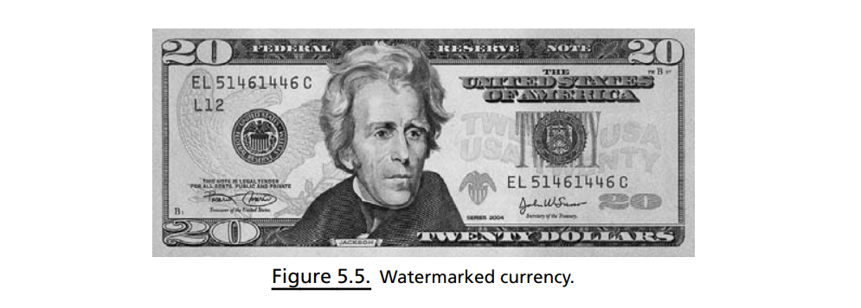
Other Crypto Related Topics
Information Hiding
Many modern currencies include (non-digital) watermarks. Several current U.S. bills, including the $20 bill pictured in Figure 5.5, have visible watermarks. In the $20 bill, the image of President Jackson is embedded in the paper itself, in the right-hand part of the bill, and is visible when held up to a light. This visible watermark is designed to make counterfeiting more difficult, since special paper is required in order to duplicate this easily verified watermark
24

Slide 25
Other Crypto Related Topics
Random Numbers
random numbers are required to generate symmetric keys. Random numbers have an important role to play in security protocols. cryptographic random numbers must be statistically random and they must also satisfy the much more stringent requirement that they are unpredictable. For example
• K_{A} for Alice
• K_{B} for Bob
• K_{C} for Charlie
• K_{D} for Dave
Alice, Bob, and Charlie don’t like Dave, so they cooperate to see whether they can determine Dave’s key. If Dave’s keyK_{D} can be predicted from knowledge of the keysK_{A}, K_{B}, and K_{C}, then the security of the system is broken.
25

Slide 26
Thank you

